Slide 1
Chapter 6. Data Modeling Data Flow Diagram

Slide 2
Models: Logical and Physical
Model – a pictorial representation of reality.
Just as a picture is worth a thousand words, most models are pictorial representations of reality.
Logical model – a nontechnical pictorial representation that depicts what a system is or does. Synonyms or essential model, conceptual model, and business model.
Physical model – a technical pictorial representation that depicts what a system is or does and how the system is implemented. Synonyms are implementation model and technical model.
Notes:
‹#›
Teaching Notes
In some books, the term logical is called a conceptual or essential. The term essential comes from the notion that the model represents the “essence” of the system.
For database-oriented instructors, the term logical in the world of systems analysis is NOT equivalent to the term logical in the world of database. In the database world, a “logical schema” is already constrained by the choice of a database technology, which runs contrary to the systems analysis expectation that a logical model is technology-independent.
In some books, the term physical is called implementation or technical.
Emphasize that there are nearly always multiple technical solutions for any given set of business requirements. In most projects, there is one logical model that represents the mandatory and desirable business requirements, regardless of how those requirements might be implemented. On the other hand, given that one logical model, there are multiple candidate physical models that could represent alternative, technical implementations that could fulfill the business requirements (although analysts rarely draw more than one or two of those physical models).

Slide 3
What is a Data Flow Diagram?
Data flow diagramming is a technique that diagrams the business processes and the data that pass among them
We use data flow diagrams (DFDs) to describe the to-be system’s interactions with its environment, processes, flows of data, and data stores
Logical process models are models that describe processes, without suggesting how they are conducted
Physical models provide information that is needed to ultimately build the system
Notes:
‹#›
No additional notes

Slide 4
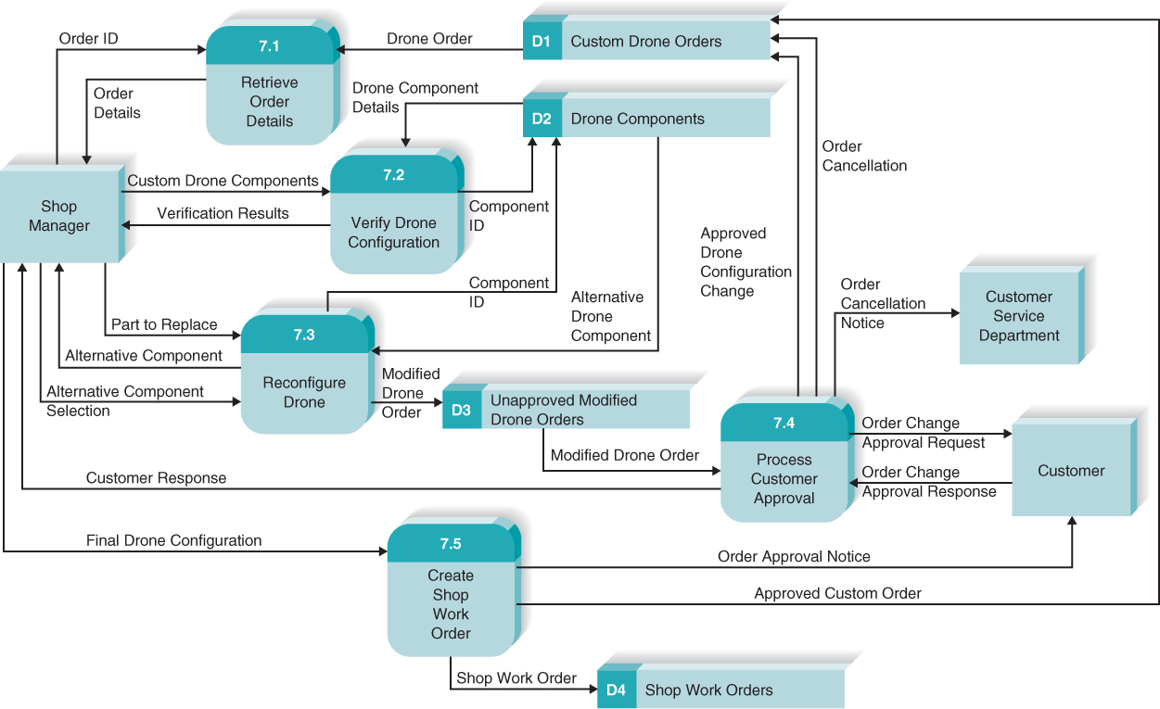

Slide 5
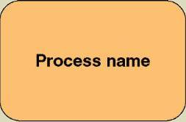
Process
Process – work performed by a system in response to incoming data flows or conditions. A synonym is transform.
All information systems include processes - usually many of them
Processes respond to business events and conditions and transform data into useful information
Modeling processes helps us to understand the interactions with the system's environment, other systems, and other processes.
Named with a strong action verb followed by object clause describing what the work is performed on/for .
Gane and Sarson shape
Notes:
‹#›
No additional notes.

Slide 6
Data Flows & Control Flows
Data flow – data that is input to or output from a process.
A data flow is data in motion
A data flow may also be used to represent the creation, reading, deletion, or updating of data in a file or database (called a data store).
Composite data flow – a data flow that consists of other data flows.
Control flow – a condition or nondata event that triggers a process.
Used sparingly on DFDs.
Data flow name
Control flow name
Notes:
‹#›
Teaching Notes
Most books do not teach “control flows.” The were initially proposed by Paul Ward in his books that extended structured analysis techniques to cover real-time systems. They are especially useful in contemporary information systems analysis because they are as close as structured analysis gets to illustrating “messages” in an object-oriented world.
Make sure students do not confuse data flows with flowchart arrows. Flowchart arrows are not named because they merely indicate “the next step.” Data flows pass actual data attributes to and from processes.
CRUD is a useful acronym from the database world to remember the basic data flows as they relate to data stores: Create, Read, Update (or change), and Delete.
One of the most common uses of composite data flows is to combine many reports into a single data flow on a high-level DFD. They can also be used to combine similar transactions on a higher level DFD before differentiating between those flows on lower-level DFDs.
Use case diagrams, an object-oriented analysis tool that also describes interfaces are taught in Chapter 7.

Slide 7


Data Stores
Data store – stored data intended for later use. Synonyms are file and database.
Frequently implemented as a file or database.
A data store is “data at rest” compared to a data flow that is “data in motion.”
Almost always one of the following:
Persons, Places, Objects etc
Data stores depicted on a DFD store all instances of data entities (depicted on an ERD)
Gane and Sarson shape
DeMarco/Yourdon shape
Notes:
‹#›
Teaching Notes
Emphasize that a data store contains all instances of a data entity (from the data model). That is why data store names are plurals (as contrasted to data entity names that are singular).
Although we don’t prefer it, some analysts designate a data store to contain all instances of several entities and relationships from a data model. For example, an ORDERS data store might include all instances of the data entities ORDER and ORDERED PRODUCT, and all instances of the relationship between ORDER and ORDERED PRODUCT—We prefer the simplicity of representing each data entity from the data model as its own data store on the process models.
Emphasize that because data stores are shared resources available to many processes, it is acceptable to duplicate them on several DFDs—The duplication does NOT indicate redundant storage (on logical DFDs); it merely represents the sharing of the data store by several processes.

Slide 8


External Agents
External agent – an outside person, unit, system, or organization that interacts with a system. Also called an external entity.
External agents define the “boundary” or scope of a system being modeled.
As scope changes, external agents can become processes, and vice versa.
DeMarco/Yourdon shape
Gane and Sarson shape
Notes:
‹#›
Teaching Notes
It is very important to emphasize the external agents on DFDs are not the same as entities on ERDs (from Chapter 7)—especially if the instructor prefers the more traditional term “external entity.”
This is true even though you could have both an entity (on an ERD) with the same name as an external agent/entity on a DFD. Consider the entity CUSTOMER and the external agent CUSTOMER:
The entity CUSTOMER indicates the requirement to store data about customers.
The external agent CUSTOMER indicates the requirement for an interaction (inputs and/or outputs) with customers.
It is very important for students to understand that external agents are “processes” outside of the scope of the system or business. As such, as scope “increases,” external agents can become processes. Conversely, if scope “decreases,” processes can become external agents.

Slide 9
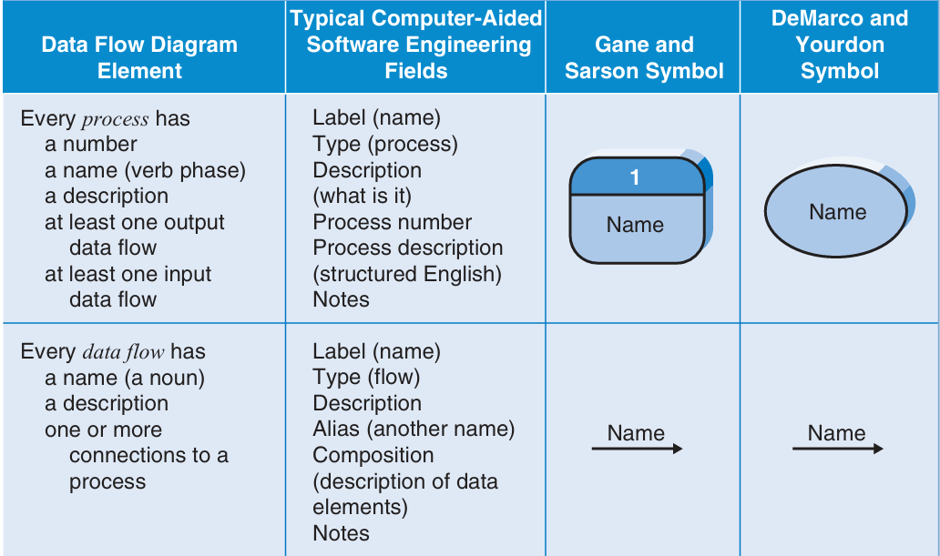

Slide 10
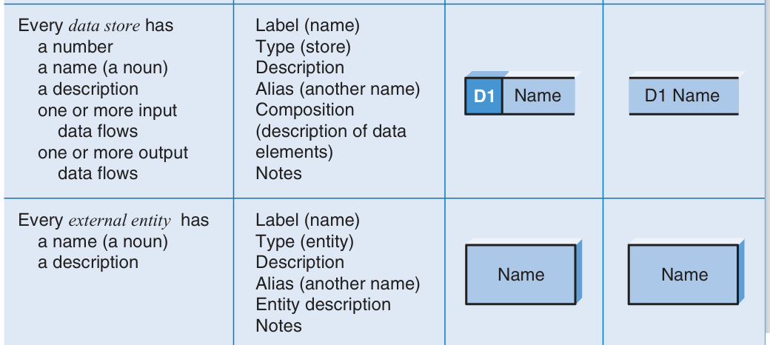

Slide 11
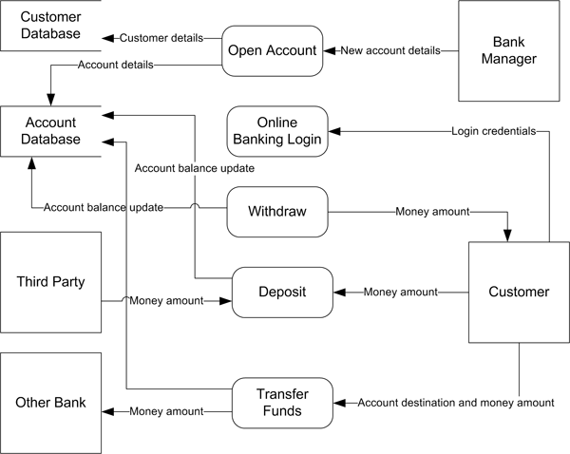

Slide 12
Common Process Errors on DFDs

Slide 13
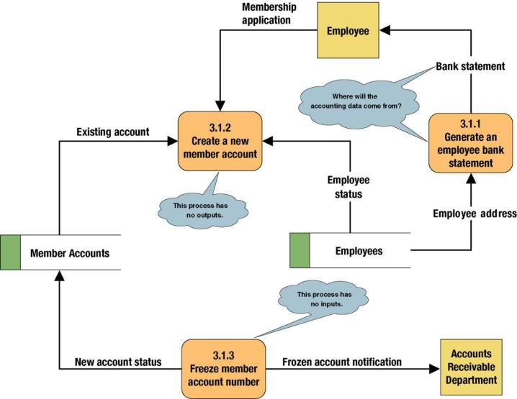
Common Process Errors on DFDs
Notes:
‹#›
Teaching Notes
Idea: Correct this diagram as an in-class exercise.
3.1.1: To correct the diagram, a data flow, ACCOUNTING DATA, should be added from the data store, MEMBER ACCOUNTS, to process 3.1.1.
3.1.2: To fix the black hole, we might add an output data flow called NEW MEMBER ACCOUNT from process 3.1.2 to the data store MEMBER ACCOUNTS.
3.1.3: To fix the miracle, you would need to at least add a data flow such as ACCOUNTING DATA from the data store, MEMBER ACCOUNTS, to process 3.1.3. In all likelihood, you also need some type of triggering data flow, such as ACCOUNT FREEZE AUTHORIZATION, from a new external agent, such ACCOUNTING DEPARTMENT, to process 3.1 3.

Slide 14
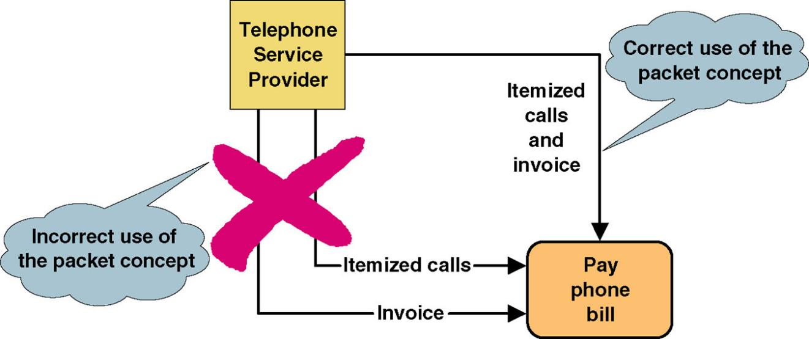
Data Flow Packet Concept
Data that should travel together should be shown as a single data flow, no matter how many physical documents might be included.

Slide 15
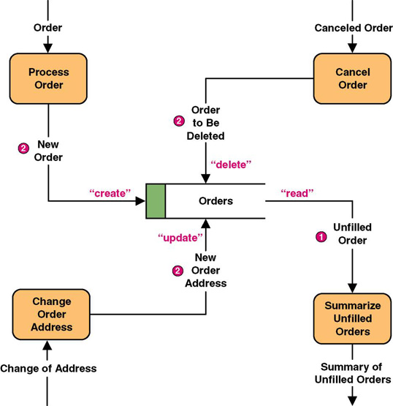
Data Flows to and from Data Stores
Notes:
‹#›
Teaching Notes
Some DFD methodologies suggest that data flows to and from data stores not be named. We think this confuses the end-users when they try to read the diagrams. Also, we believe that it is easier to have DFD errors of omission if the rules state that some flows are named while others are not.
Some DFD notations actually use the CRUD letters only to name flows to and from data stores. We consider this an acceptable alternative. CRUD is a useful acronym from the database world to remember the basic data flows as they relate to data stores: Create, Read, Update (or change), and Delete.

Slide 16
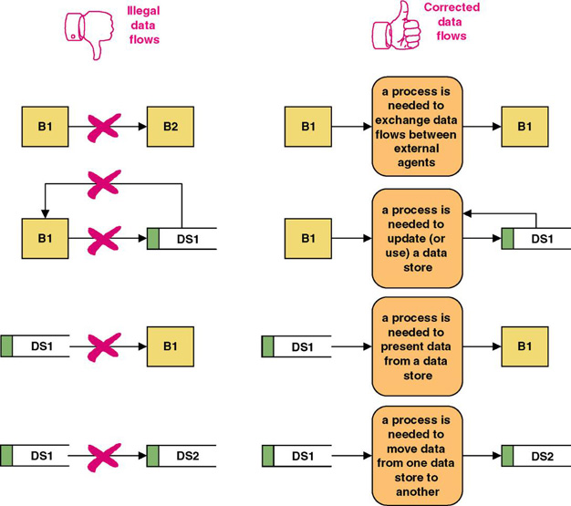
Rules for Data Flows
A data flow should never go unnamed.
In logical modeling, data flow names should describe the data flow without describing the implementation
All data flows must begin and/or end at a process.
Notes:
‹#›
No additional notes.

Slide 17
Diverging and Converging Data Flows
Diverging data flow – a data flow that splits into multiple data flows.
Indicates data that starts out naturally as one flow, but is routed to different destinations.
Also useful to indicate multiple copies of the same output going to different destinations.
Converging data flow – the merger of multiple data flows into a single packet.
Indicates data from multiple sources that can (must) come together as a single packet for subsequent processing.
Notes:
‹#›
No additional notes.

Slide 18
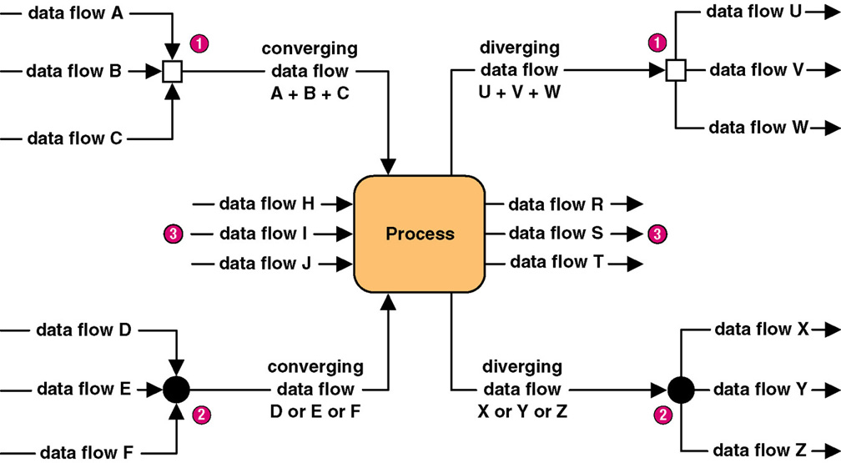
Diverging and Converging Data Flows
Notes:
‹#›
Teaching Notes
Different CASE tools use different notations to illustrate converging and diverging data flows. In fact, some CASE tools do not even support this concept.

Slide 19
Exercise: Order food
Draw a Data Flow Diagram (DFD) for “Food Ordering System” considering the following scenarios:
Customer place an Order. The Order Food process receives the Order, forwards it to the Kitchen, store it in the Order data store, and store the updated Inventory details in the Inventory data store. The process also delivers a Bill to the Customer. Manager can receive Reports through the Generate Reports process, which takes Inventory details and Orders as input from the Inventory and Order data store respectively. Manager can also initiate the Order Inventory process by providing Inventory order. The process forwards the Inventory order to the Supplier and stores the updated Inventory details in the Inventory data store.

Slide 20
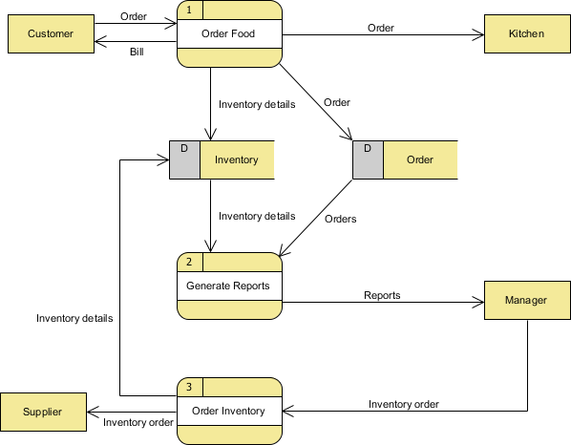

Slide 21
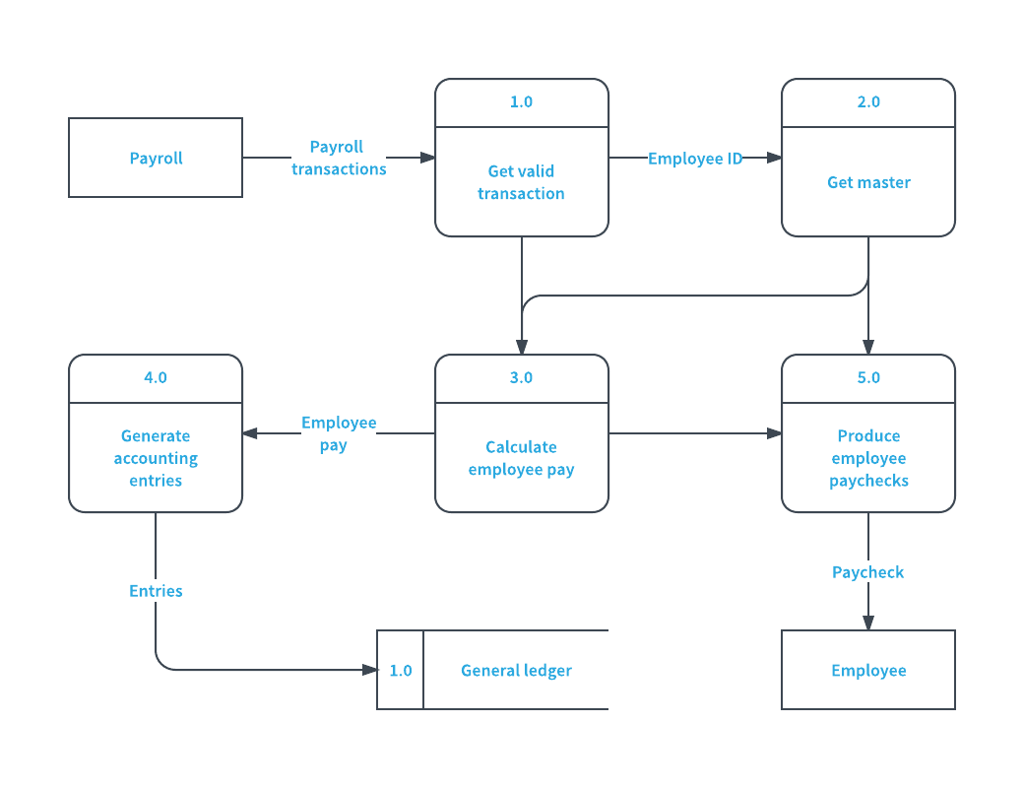
Payroll management system

Slide 22
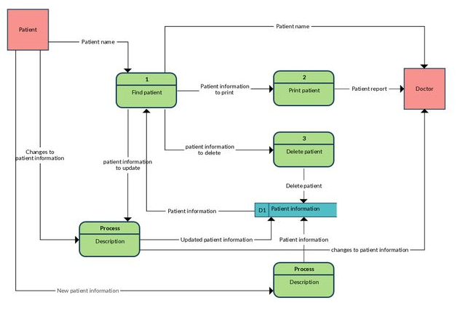
Patient Information system

Slide 23
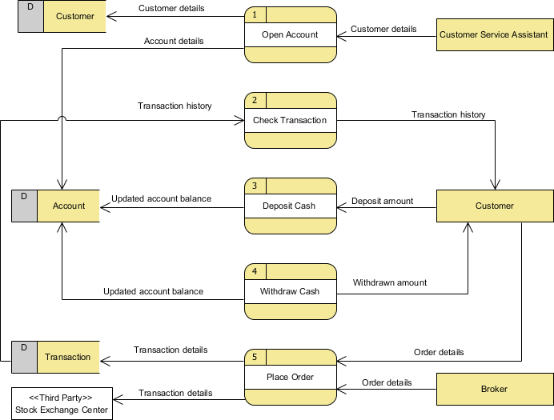

Slide 24
Process Decomposition

Slide 25
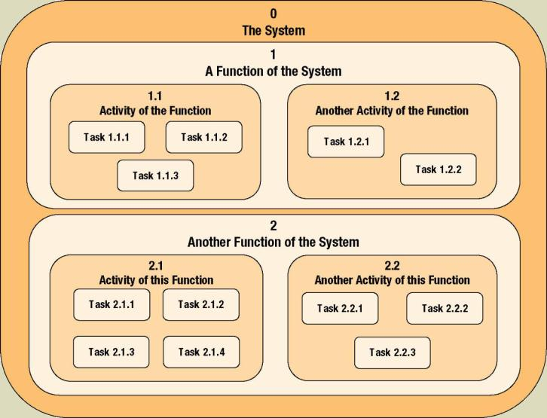
Process Decomposition
Decomposition – the act of breaking a system into sub-components. Each level of abstraction reveals more or less detail.
Notes:
‹#›
No additional notes

Slide 26
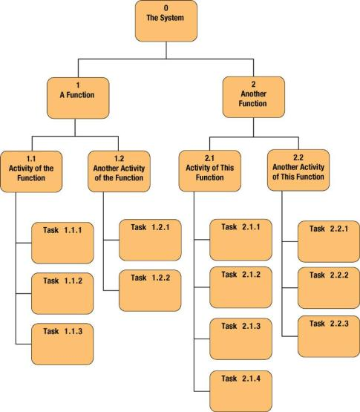
Decomposition Diagrams
Decomposition diagram – a tool used to depict the decomposition of a system. Also called hierarchy chart.
Notes:
‹#›
Teaching Notes
Decomposition is a top-down problem-solving approach.
It might be useful to point out the numbering scheme. This scheme is common, but we do not like it because if the system is restructured, it forces renumbering all processes.
Some instructors like to do a quick example using a small but realistic problem.

Slide 27
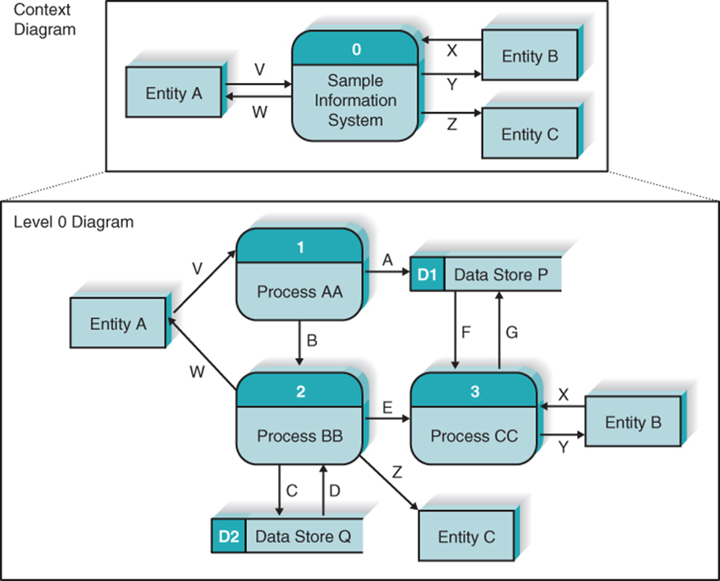
DFD Hierarchy (1 of 3)

Slide 28
DFD Hierarchy (2 of 3)
Processes on Level 0 diagram each decompose into separate Level 1 diagrams
Processes on Level 1 diagrams may or may not be decomposed into separate Level 2 diagrams
Processes are decomposed until each process is a single-purpose, primitive process

Slide 29
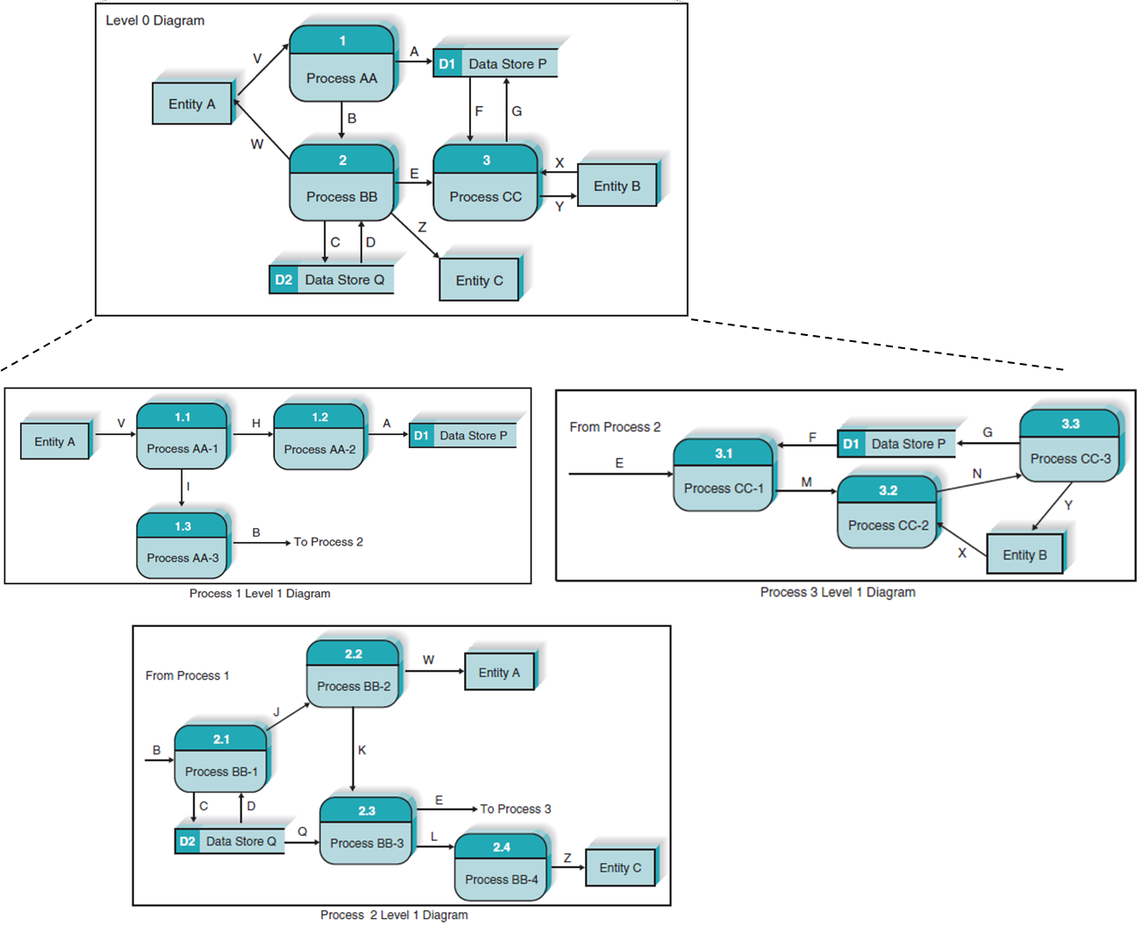
DFD Hierarchy (3 of 3)

Slide 30
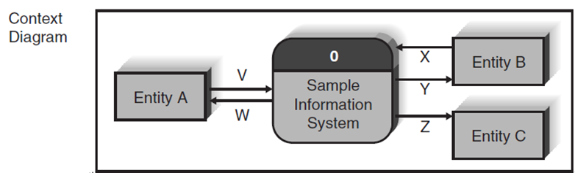
Context Data Flow Diagram
Context data flow diagram - a process model used to document the scope for a system. Also called the environmental model.
Top-level DFD in every process model
Think of the system as a "black box."
Ask users what business transactions the system must respond to. These are inputs, and the sources are external agents.
Ask users what responses must be produced by the system. These are outputs, and the destinations are external agents.
Identify any external data stores, if any.
Notes:
‹#›
Teaching Notes
This may be review from chapter 5.

Slide 31
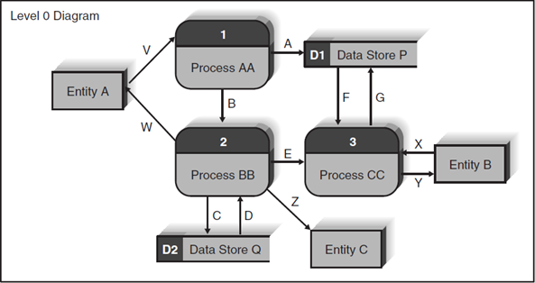
Level 0 Diagram
Shows all the major processes that comprise the overall system
Internal components of process 0
Shows how the major processes are interrelated by data flows
Shows external entities and the major processes with which they interact
Adds stored data via the data stores
Notes:
‹#›
No additional notes

Slide 32
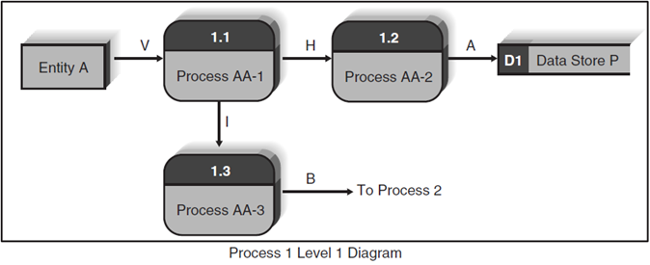
Level 1 Diagrams
Create one level 1 diagram for every major process on level 0 diagram
Shows the internal processes that comprise a single process on the level 0 diagram
Shows how information moves to and from each of these processes
If a parent process is decomposed into, say, three child processes, then these three child processes wholly and completely make up the parent process
Notes:
‹#›
No additional notes

Slide 33
Level 2 Diagrams
Shows all processes that comprise a single process on the level 1 diagram
Shows how information moves from and to each of these processes
Level 2 diagrams may not be needed for all level 1 processes
Correctly numbering each process helps the user understand where the process fits into the overall system
Notes:
‹#›
No additional notes

Slide 34
Diagram Numbering
Correctly numbering each process helps the user understand where the process fits into the overall hierarchy
Context Diagram is always “Process 0”
Level 0 processes are always numbered with integer value (1, 2, 3, and so on)
Level 1 processes always have one “dot”: parent number “dot” unique number (1.1, 1.2, 1.3, and so on)
Level 2 processes always have two “dots”: parent number “dot” unique number (1.1.1, 1.1.2, 1.1.3, and so on)

Slide 35
Balancing
Balancing - a concept that requires that data flow diagrams at different levels of detail reflect consistency and completeness
Quality assurance technique
Requires that if you explode a process to another DFD to reveal more detail, you must include the same data flows and data stores
Notes:
‹#›
Teaching Notes
Discuss balancing with the class, the concept that requires that data flow diagrams at different levels of detail reflect consistency and completeness.

Slide 36
Validating the Data Flow Diagrams
Process | Every process has a unique name that is an action-oriented verb phrase, a number, and a description. Every process has at least one input data flow. Every process has at least one output data flow. Output data flows usually have different names than input data flows because the process changes the input into a different output in some way. There are between three and seven processes per D F D.
Data Flow | Every data flow has a unique name that is a noun, and a description. Every data flow connects to at least one process. Data flows only in one direction (no two-headed arrows). A minimum number of data flow lines cross.
Data Store | Every data store has a unique name that is a noun, and a description. Every data store has at least one input data flow (which means to add new data or change existing data in the data store) on some page of the process model. Every data store has at least one output data flow (which means to read data from the data store) on some page of the process model.
External Entity | Every external entity has a unique name that is a noun, and a description. Every external entity has at least one input or output data flow.

Slide 37
Creating Data Flow Diagrams (1 of 2)
Build the context diagram
Identify the external entities and the major inflows they supply and the outflows they receive
Identify all major processes encompassed by the Context Diagram
Each major event / use case is “handled” by a process
Create DFD “fragments” for each event / use case
Each DFD fragment is a mini-diagram showing the process and the external entities and data stores with which it interacts

Slide 38
Creating Data Flow Diagrams (2 of 2)
Organize DFD fragments into level 0 diagram
Decompose each level 0 process into a level 1 diagram; decompose level 1 processes into level 2 diagrams as needed; etc.
Validate DFDs with user to ensure completeness and correctness

Slide 39
Illustration – Developing DFDs
Creating the context diagram
Create a DFD “fragment” based on a use case
Merge DFD “fragment” diagrams into the Level 0 diagram
Develop level 1 diagrams for every process on the level 0 diagram

Slide 40
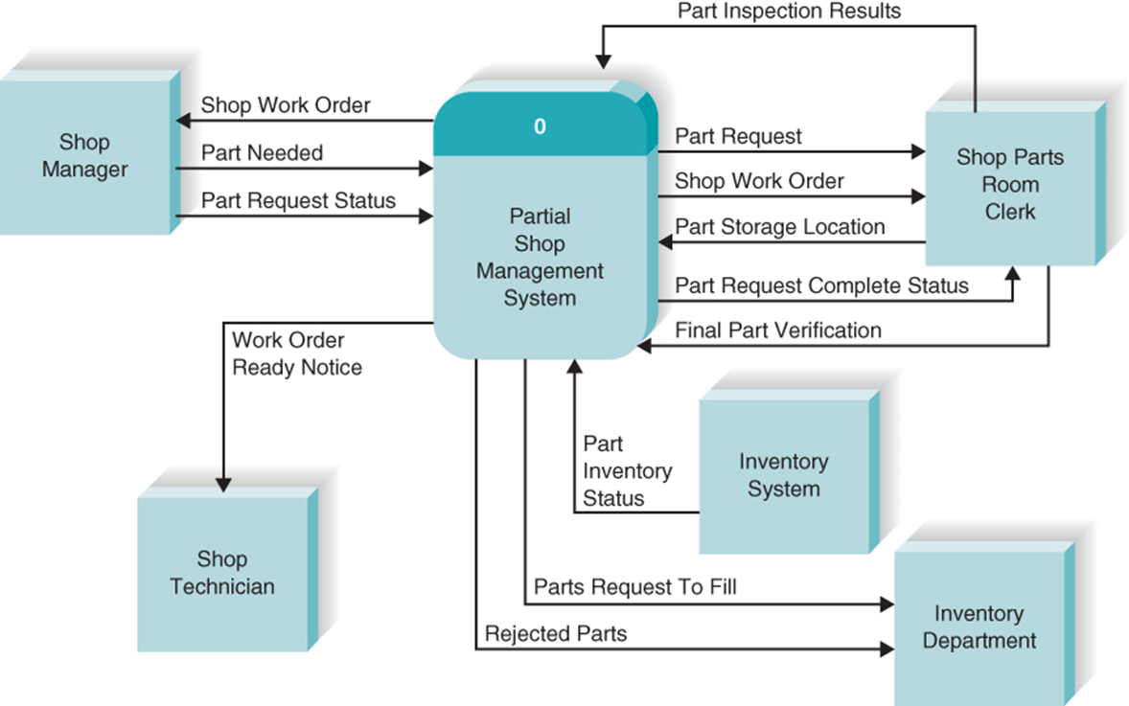
Creating the Context Diagram

Slide 41
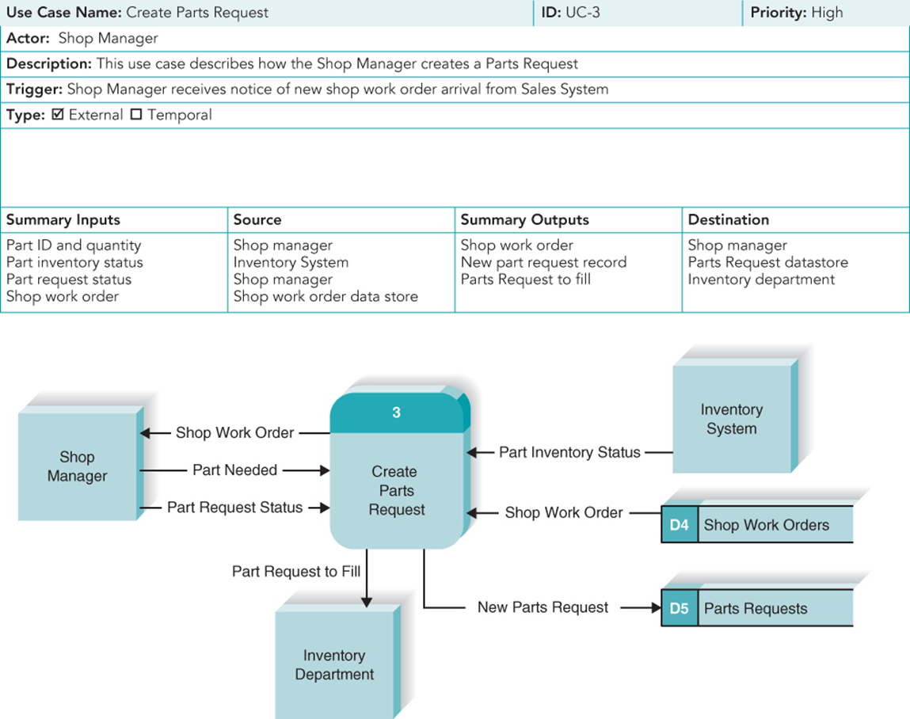
Create a DFD “Fragment” Based on a Use Case

Slide 42
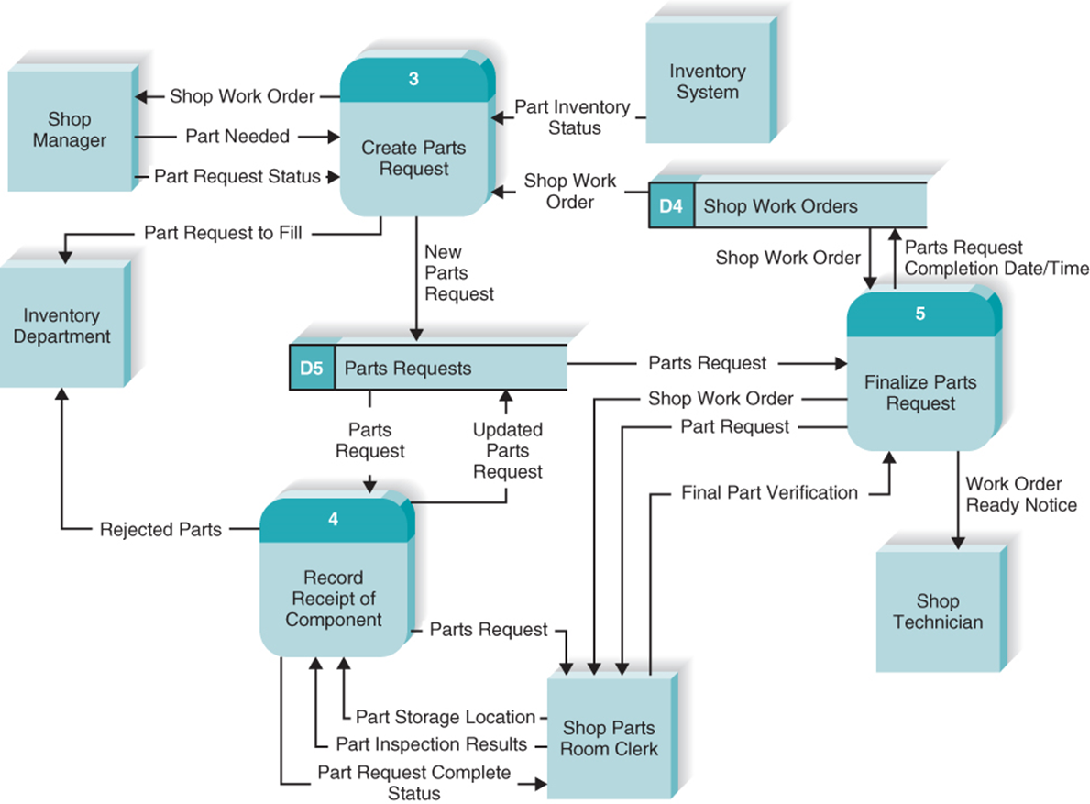
Merge DFD “Fragment” Diagrams into the Level 0 Diagram

Slide 43
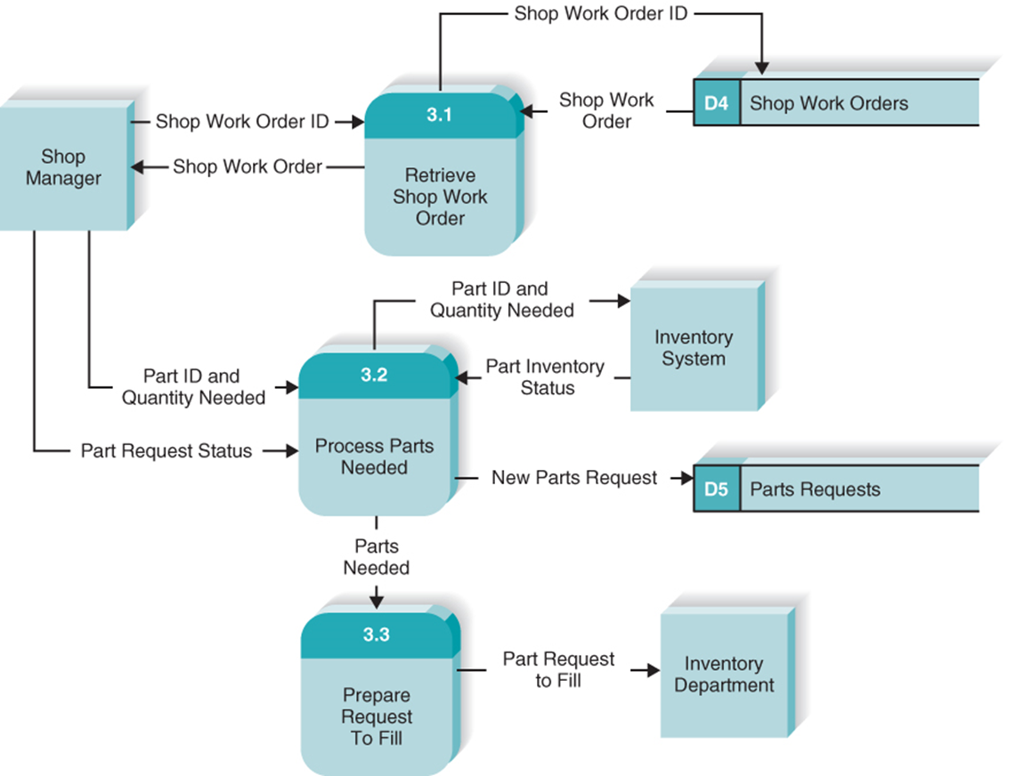
Level 1 – Process 3: Create Parts Request

Slide 44
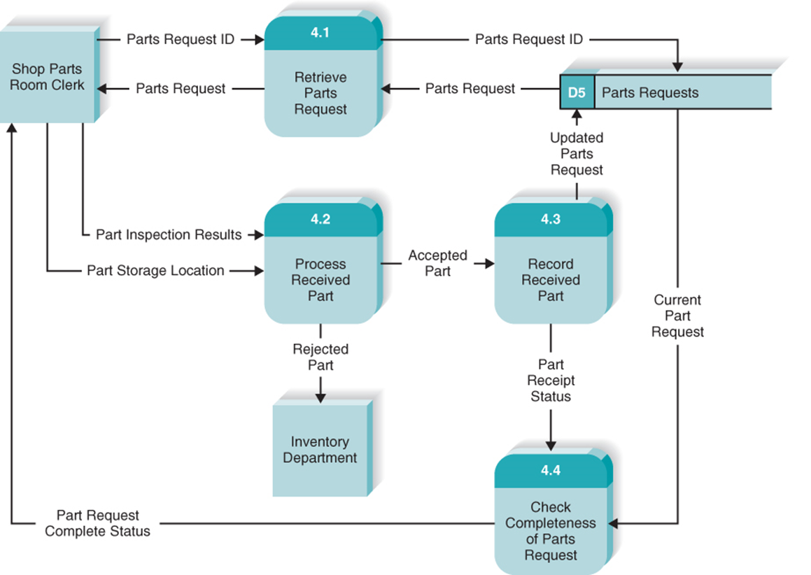
Level 1 – Process 4: Record Receipt of Components

Slide 45
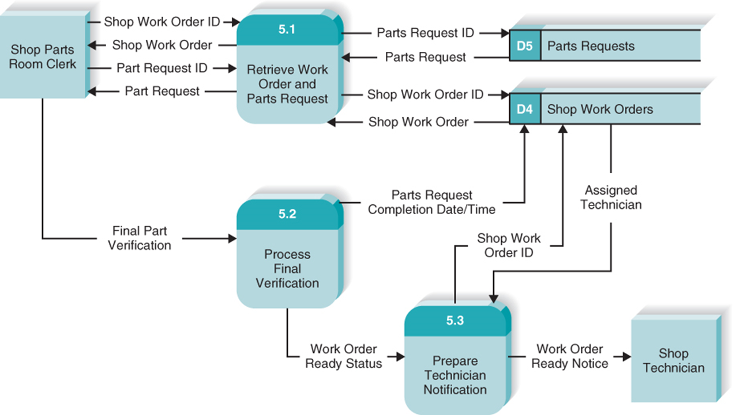
Level 1 – Process 5: Finalize Parts Request

Slide 46
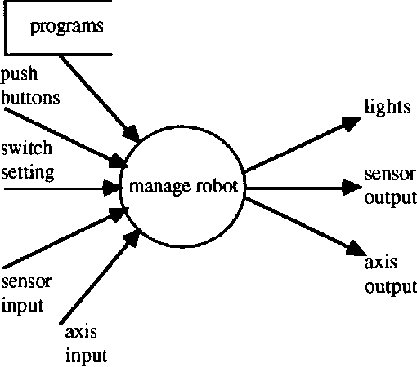
Manage Robot

Slide 47
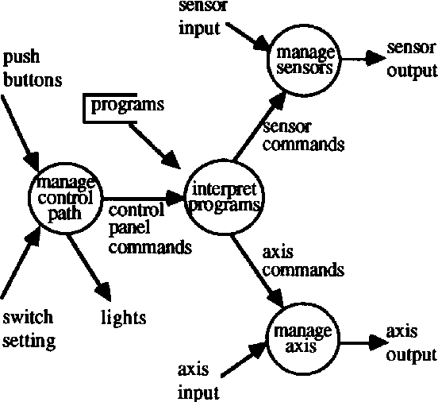
Manage Robot decomposed

Slide 48
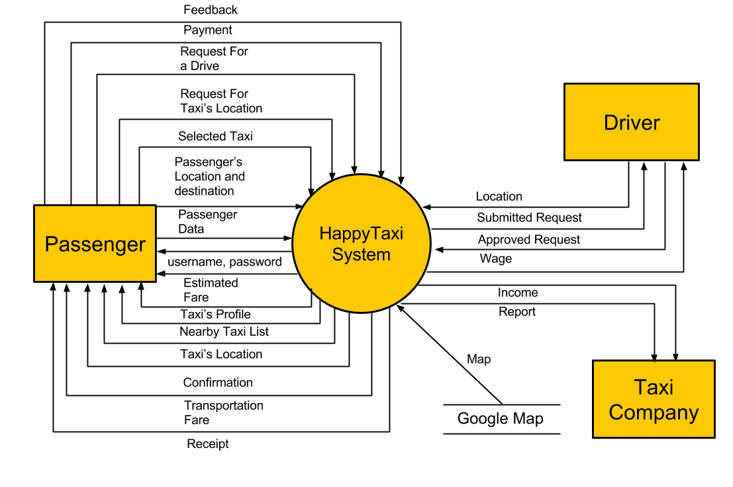

Slide 49
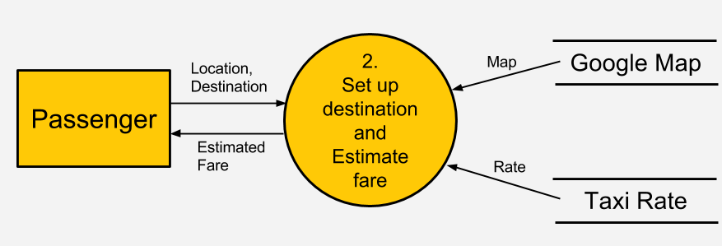
Here passenger input current location and destination address to set up destination and estimate fare process and the process send estimate fare to the passenger. The same process gather map information from Google map and rate from taxi rate data base.

Slide 50
Class work
Draw level 1 DFD where set up destination and estimate fare process as decomposed into two sub processes as get distance and calculate fare. Data of distance will be sent from get distance to calculate fare.
Draw Level 2 DFD for get distance sub process. Decompose get distance in two sub processes as get route and calculate distance. Data of route will sent from get route to calculate distance.

Slide 51
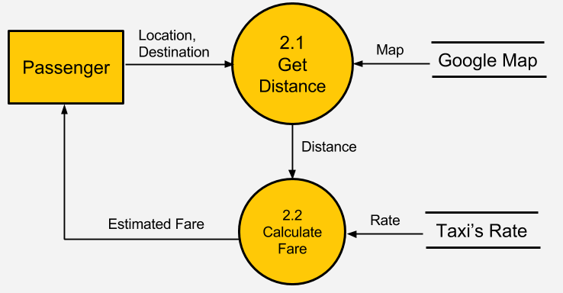
Draw level 1 DFD where set up destination and estimate fare process is decomposed into two sub process as get distance and calculate fare. Data of distance will sent from get distance to calculate fare.

Slide 52
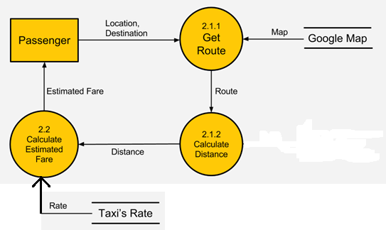
Draw Level 2 DFD for get distance sub process. Decompose get distance in two sub process as get route and calculate distance. Data of route will sent from get route to calculate distance.

Slide 53
Chapter Review
Define the meaning and purpose of the four basic symbols found on a data flow diagram.
Explain the concept of decomposition and why process models are created as a hierarchy of DFDs.
Describe several common syntax and semantic errors found on DFDs.
Discuss the process used to create a process model.
Discuss how the process model contributes to the development of the new information system.

